Slide 1
Microservices and DevOps
DevOps and Container Technology
Testability: An Architectural Quality Attribute
Henrik Bærbak Christensen

Slide 2
Testability
Testability: Concerned with the ease with which the software can be made to demonstrate its faults
Thus an estimate of effort (to make test) and efficiency (probability of finding a failure)

Slide 3
Testability
Testability: Concerned with the ease with which the software can be made to demonstrate its faults
Techniques:
Testing:
Review
Manual: Structured and systematic human reading of programs
Static analysis: let programs analyze your program
Formal verification: make profs that you program works

Slide 4
Failure and Defects
What we observe when testing
Why we observe it – the cause
På dansk: Fejl og fejl ☺

Slide 5
Terminology
Test Case
Which means:
We have to isolate some part of the software – the ‘unit’
We have to be able to provide input to the unit
We have to be able to execute the unit with the input and observe the output (which requires a specific context)
We have to know what output to expect (oracle)
(input, output, unit under test)

Slide 6
Test Case
Manual Testing
Automated Testing
Trend: Towards automated
Netflix, Uber, MS, Google, …

Slide 7
… Can be difficult!
Because: It is difficult or tedious to provide input
Start a web server with five dependent systems
Ensure that the two databases used are in a correct state,
One is that Arne is a registered user in the user database
Another that Arne’s current balance on his account is 200€
Log in Arne from the web page
Go to the account page and enter (300€, Birte) in the ‘transfer funds’ page.
Validate that transfer is refused and the message is ‘out of funds’

Slide 8
… Can be difficult!
Because: It is difficult or tedious to provide input
Start a web server with five dependent systems
Ensure that the two databases used are in a correct state,
One is that Arne is a registered user in the user database
Another that Arne’s current balance on his account is 200€
Log in Arne from the web page
Go to the account page and enter (300€, Birte) in the ‘transfer funds’ page.
Validate that transfer is refused and the message is ‘out of funds’
Tedious to set object’s state to well defined values before executing the test.
(And resetting is hell!)
Tedious to enter the input parameters of the test case.
Tedious to verify expected output match computed output

Slide 9
… Can be difficult!
Because: Difficult to execute unit in isolation
If unit deeply nested inside a complex system
Impossible/difficult to isolate
Difficult to control surrounding units
Anti decomposition axiom:
”You cannot fully test a module through testing the system”
Anti composition axiom:
”You cannot fully test a system through testing all units”

Slide 10
… Can be difficult!
Because: It is difficult to get the output
If the thing we need to validate is printed in a mail that the system sends to a user
Have to log in as this user, open mail box, verify contents
If the proper answer is that the graphite rods are fully extracted from our nuclear core
If the proper answer is that 250 states change in 125 different systems

Slide 11
… Can be difficult!
Because: Given we have the output, what is the correct expected output?
Big legacy systems tend to do stuff which we knew why happens – a decade ago…
And user rely on what it has always been doing, not what it was specified to do!
War story:
use the algorithm itself to compute the answer to expect

Slide 12
… Can be difficult
Because: Any change potentially require regression testing!
Let us face it:
It is expensive so either
Our product becomes too expensive
We just hope for the best
WarStory: The 1.000 hour manual test system…

Slide 13
Testing Issues in Summary
Definition: The Testability Input Issue
Embody the issues involved in providing comprehensive and deterministic input to the unit under test in a reliable and reproducible way
Definition: The Testability Unit Isolation Issue
Embody the issues involved in testing a unit under test in isolation in a comprehensive environment in a reliable and reproducible way
Definition: The Testability Output issue
Embody the issues involved in recording the output from a unit under test and asserting the correctness in a reliable and reproducible way

Slide 14
Testability Tactics

Slide 15
Tactic
Tactics: Architectural techniques to achieve required quality attributes
i.e. control the response measure in a positive direction
So
Architectural techniques to increase testability

Slide 16
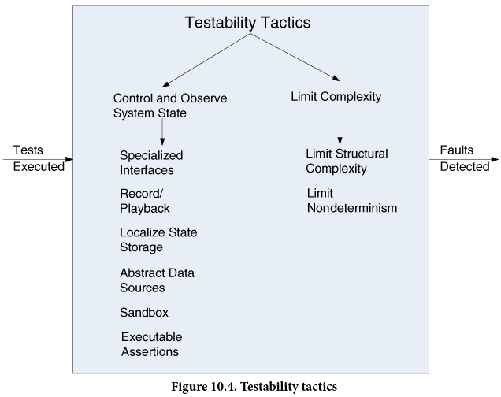
Testability Tactics

Slide 17
Tactics
Control/observe system state
Specialized interfaces
Encapsulation works against validating intermediate results
Compare Spy’s retrieval interface
Record/playback
Record interaction at interface boundary for later playback
Many web testing tools (Selenium a.o.) work this way
Localize state storage
To enable testing when UUT is in particular state
Ex: Backgammon rules change at end of game, but tedious to get there if by moving one piece at a time
Abstract data sources
Make it easy to control UUTs input data
Stubs, program to an interface and use delegation

Slide 18
Tactics
Control/observe system state
Sandbox
Isolate system from ‘real world’ to enable experimentation
Isolate from production data and env
Allow transactions to be easily rolled back
Use Virtualized resources / VMs
Use stubs, mocks, dependency injection for
Real clocks, real hardware, real sensors, real …
Executable assertions
Class level invariants, pre- and post-conditions
Checked continuously at run-time

Slide 19
Tactics
Limit Complexity
Limit structural complexity
Make smaller and more cohesive abstractions
High cohesion, low coupling, separation of concern
Eventual consistency easier than always consistent
Simpler code and easier to test
Limit non-determinism
Avoid non-determinism as best possible
Stubbing randomness for instance

Slide 20
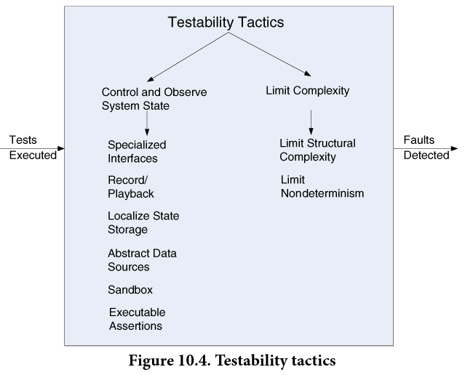
Evolving World
Also here I find a tactic missing (or a category)
‘Ease of demonstrate faults’ equals speed!
Test Process
Automation
RegressionSpeed
Monitoring

Slide 21
Tactic
Test Process Tactics
Automation: Ensure that tests are executed automatically/programmatically, not by hand
xUnit frameworks
Continuous Integration servers on dedicated branches
Regression Speed: Ensure your automated tests can be executed fast. Unit tests in seconds, integration/service tests in minutes, system/end-to-end tests in hours.
Service Doubles

Slide 22
Tactic
Test Process Tactics
Monitoring: Monitor production systems and report anomalies
Monitor log messages
Monitor physical server farm health
Simian army to produce failure conditions in prod.

Slide 23
Testability and MSDO
I did not sign up for a test fagpakke, did I?

Slide 24
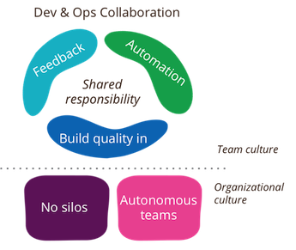
Yes you did ☺
DevOps Culture [Rouan Wilsenach, 2015] (https://www.martinfowler.com/bliki/DevOpsCulture.html)
We need
Fast feedback
Quality Code
Automation
Main technique
Automated regression testing

Slide 25
So – in General
All features/quality attributes should be demonstrated through automated testing in this course
Write JUnit code to validate at unit testing level
Using test doubles to control indirect input and ouput
Write JUnit+TestContainer code to validate at integration testing level
Use real-life containers to handle deterministic input and output
(And test double services or test doubles for non-determ.)

